Slide 1


OOP PROJECT
FLEXDEALS SHOPPING WEBSITE:
GROUP-11
CSE 3rd SEM

Slide 2


OOP Project
TEAM MEMBERS
Rohit Khetan
20BCS114
20BCS125
20BCS126
20BCS128
20BCS129
Somisetty Sai Praneeth
Soumya Ranjan Sahu
Sreedeva Krupananda B Reddy
Sri Hari L

Slide 3
Project Description :
Why would you need such a platform?
01
FlexDeals Shopping Website
This platform makes online shopping as simple as possible and allows users to save both time and money.
What does the website do?
This website allows the users to access the products that are available in discount sales on various websites in one place.
02
How does the website work?
The website provides a link with the product chosen by the user that redirects to the original website of the product
03

Slide 4
To provide a customer with the best deal of the Products.
PROJECT OBJECTIVES:
Deals and offers are updated in real- time.
User-friendly UI for smoother navigation and faster results.
Supported in a large number of devices.

Slide 5





SOFTWARE:
FRONTEND
BACKEND

Slide 6
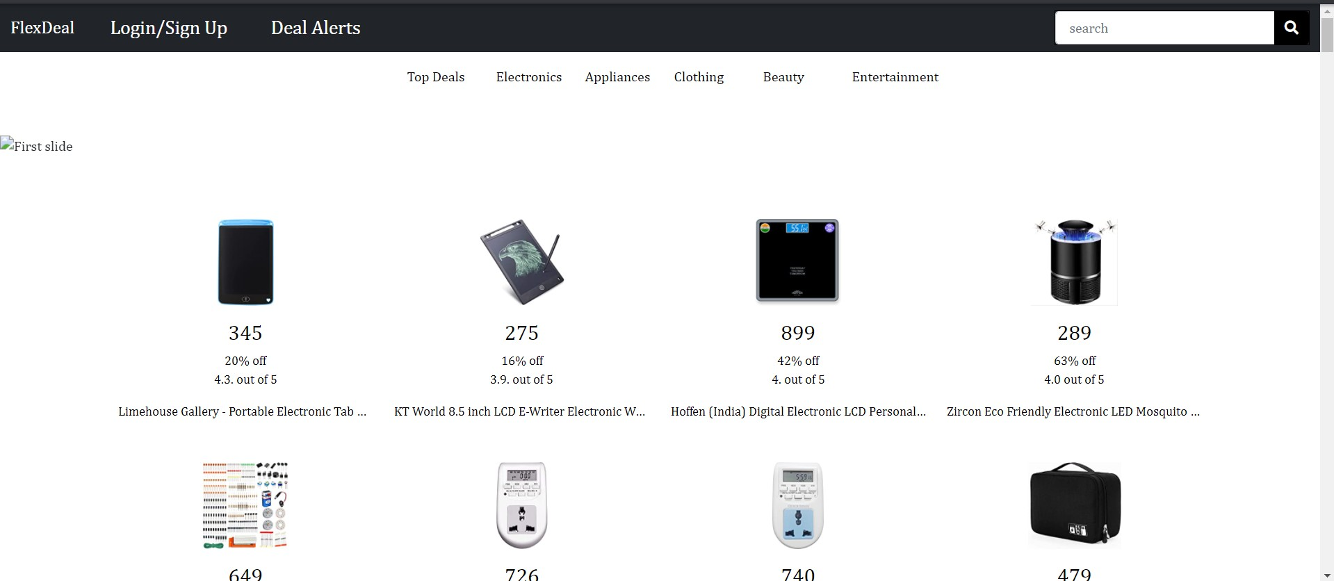
SNAP OF HOME PAGE
OOP Project

Slide 7
TIMELINE:
Week 1
Week 2
Decide the Project with Group Members
Break the project down into manageable parts & create a mind map of things to do.
Assign tasks to the members of the
group.
Learning Phase
Finish out presentation.
Start Collecting Tools and Resources for Web Development
Week 3
Week 4
Design a user-friendly website.
Finish the front-end & back-end development.
Deployment and testing of the
website.
Evaluate & collect feedback on the website's performance.
Fix bugs & adapt it to the user's needs.
Ensure that the project is completed on schedule.

Slide 8

Work Distribution:
Somisetty Sai Praneeth Sreedeva Krupananda B Reddy Rohit Khetan
Sri Hari L
Soumya Ranjan Sahu
: Python + Django
: Django + Python
: HTML + CSS + Bootstrap
: Python + HTML
: HTML + CSS + Bootstrap

Slide 9
Users can review and rate the product.
Users can get view the price history of a particular product.
Future Plans
Users can search the products over a fixed range of prices.
Users can use the coupons for their purchases.
Users can create a wishlist of products to track the price of. The user gets a notification where there is a change in the deal.

Slide 10
Thank you

